Slide 1
Hardware Software Platforms Project Presentation
WiFi Communication Server-Client with ESP8266 and Webserver with ESP8266
José Huertas Pedroche (jose_22_hp@hotmail.com)
Amanda Bersen Borges
(amandabesenborges@gmail.com)

Slide 2
Summary
Introduction
Wifi Communication between 2 ESP8266
WebServer with ESP8266
The Union of both Parts
Simulations
Conclusion

Slide 3
Introduction
The main project:
Communication between two Web pages through two WiFi communications using two ESP8266.
GitHub: https://github.com/MandyBB/Web-server-messenger-between-two-ESP8266-using-wifi-communication
The objectives:
Learn how works the WiFi protocol at an ESP8266.
Work at different types of WiFi communication.

Slide 4
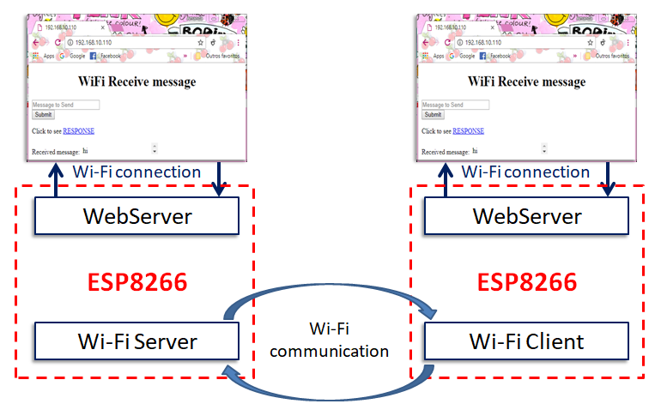
Main Scheme

Slide 5
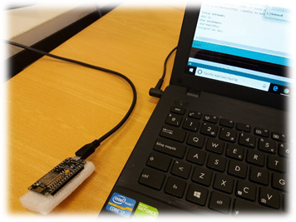
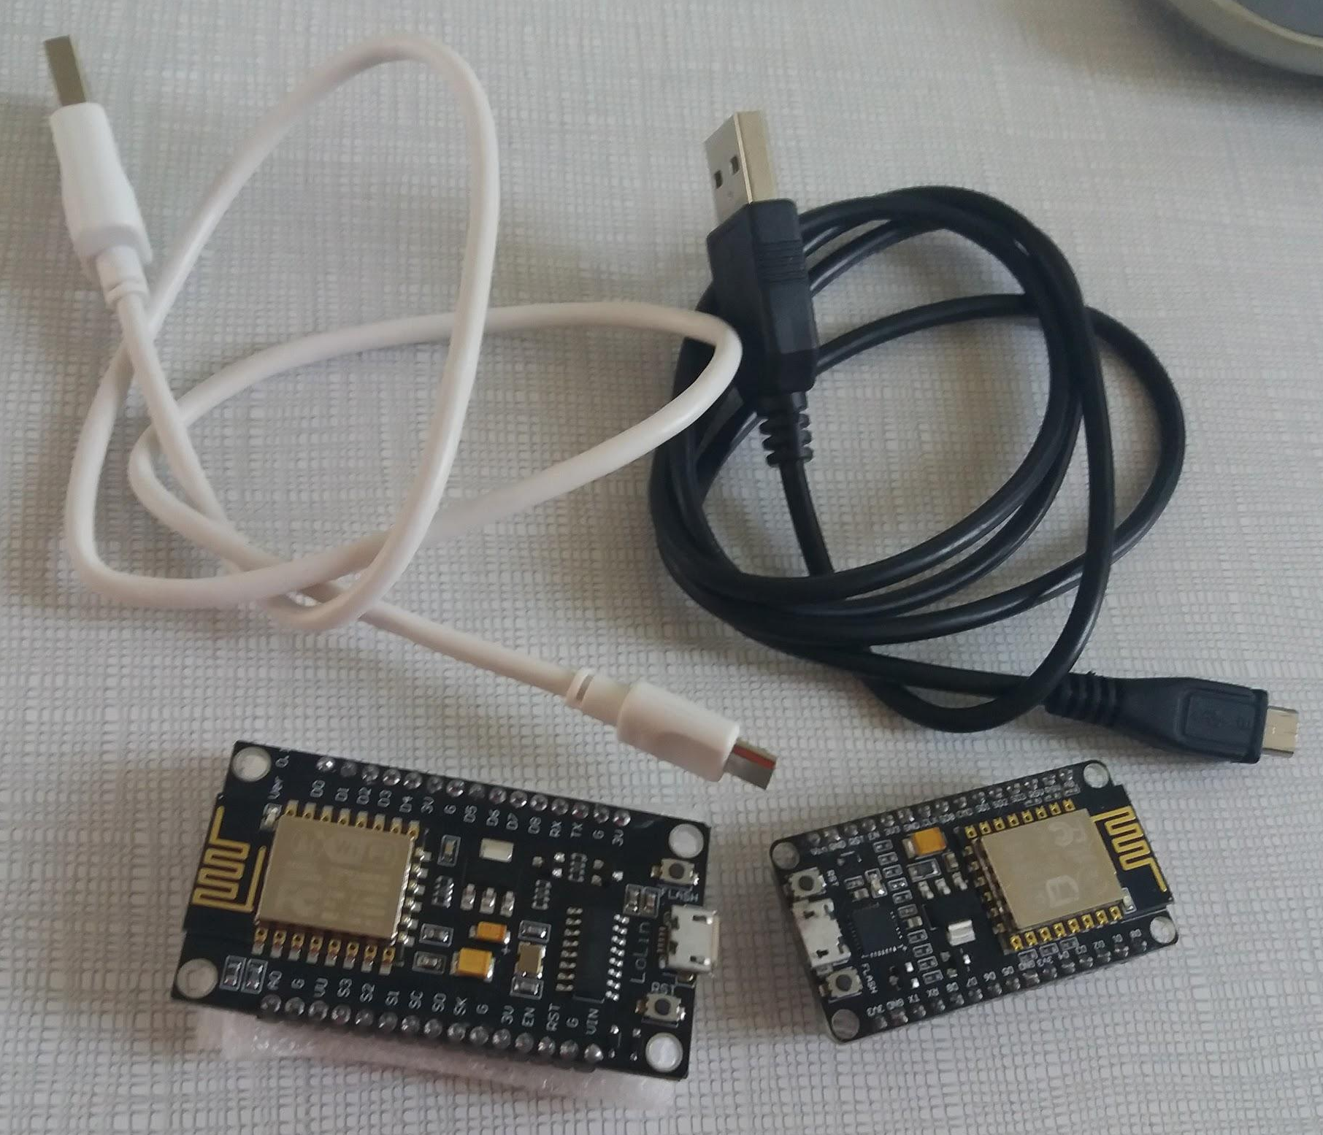
Material Used
Computers with Arduino Software IDE installed
Two ESP8266
Two USB cable

Slide 6
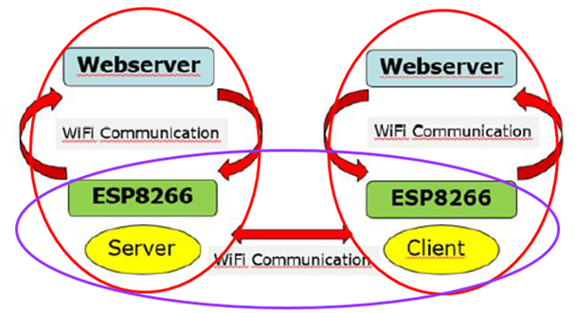
Block Diagram
The Project is divided in two big parts:
Red Part: Creation of two Web servers that communicate with the ESP8266s by WiFi.
Blue Part: WiFi communication between the two ESP8266

Slide 7
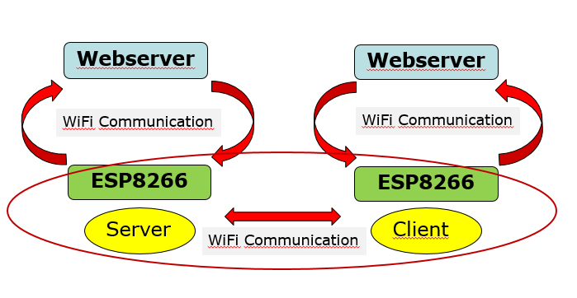
WiFi Communication Between two ESP8266

Slide 8
Tutorial
UDP Android ESP
Github link: https://github.com/gowgear/UDP-Android-ESP

Slide 10
Our GitHub link:
https://github.com/MandyBB/Wifi-Communication-with-two-ESP8266

Slide 11
Webserver with ESP8266
Block Diagram:
Webserver
Webserver
WiFi Communication
WiFi Communication
ESP8266
ESP8266
Server
Client
WiFi Communication

Slide 12
Tutorial
ESP8266 Web Server with HTML Web Page
https://circuits4you.com/2016/12/16/esp8266-web-server-html/
ESP8266 Arduino WiFi Web Server LED on off control
https://circuits4you.com/2018/02/05/esp8266-arduino-wifi-web-server-led-on-off-control/
ESP8266 First Web Server
https://tttapa.github.io/ESP8266/Chap10%20-%20Simple%20Web%20Server.html

Slide 14
Our GitHub link:
https://github.com/josehp22/Webserver-with-ESP8266

Slide 15
The Union of both Parts
Main Issue
TWO WiFi configurations for ONE WiFi module.

Slide 16
[1] - Turn on Wi-Fi communication as Server;
Wait for msg;
[2] - Turn on WebServer;
Wait for msgWB from WebServer;
if (msgWS arrives):
[2] - Stores the msgWS in msg;
Turn off WebServer;
Turn on Wi-Fi Communication as Client;
Send msg to [1];
[1] - Listen msg;
Send ConfMsg for confirmation of received msg to [2];
[2] - Receives ConfMsg;
Stop sending msg;
Turn off Wi-Fi Communication as Client;
[1] - Turn off Wi-Fi communication as server;
Turn on WebServer;
Send msg to WebServer;
[2] - Turn on Wi-Fi Communication as Server;
Wait for msg;
[2] = [1] and [1]=[2];
return;
[1] and [2] - ESP8266 1 and 2.
msg - message broadcasted
msgWB - message from Web Server.

Slide 17
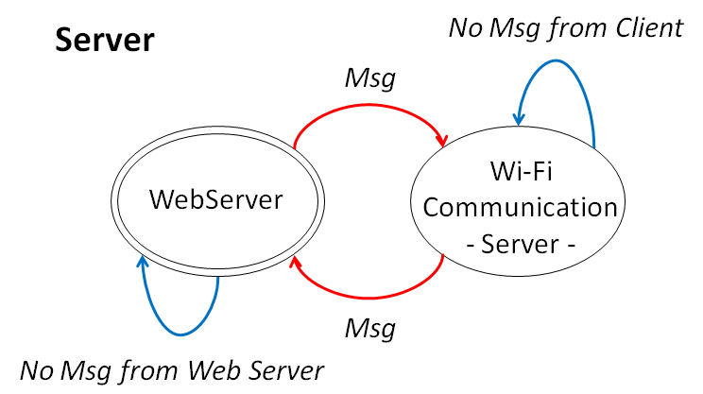
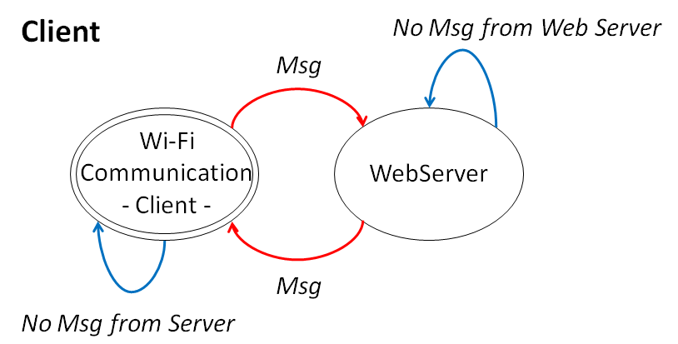
Switch (Aux){
Case 1:
Web Server on;
if there is msgWS {
Aux = 2;
Clean msgWC;
}
Case 2:
Wifi Communication on;
if there is msgWC{
Clean msgWS;
Aux = 1;
}
}

Slide 18
Simulation
2 Simulations:
The Server;
The Client.

Slide 19
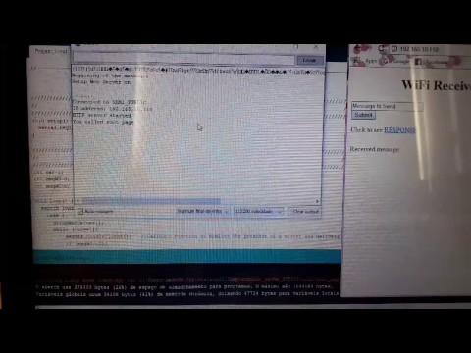
1st Simulation

Slide 20
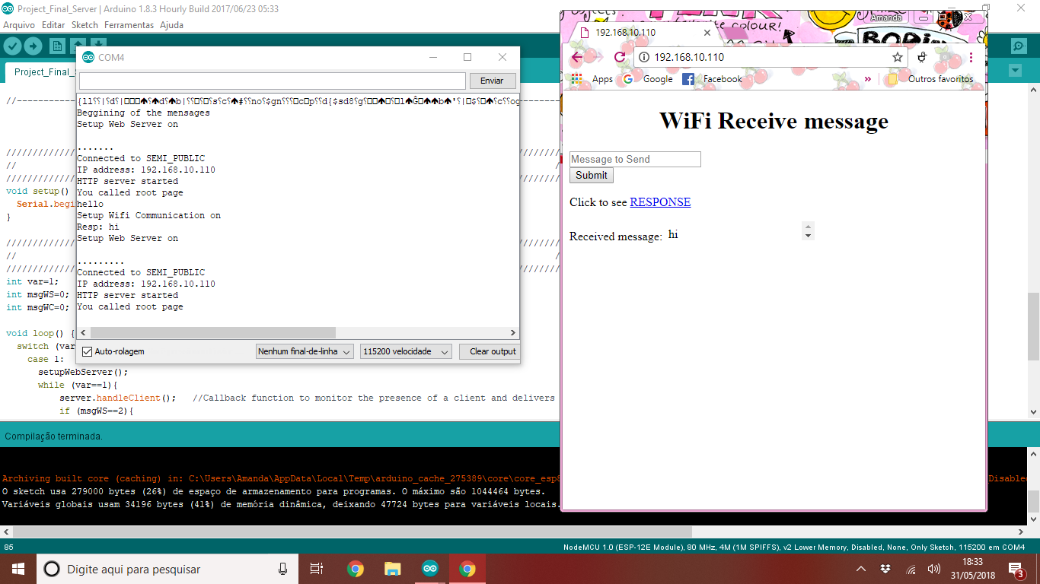
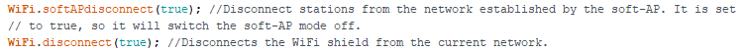
2nd Simulation
Turn on Wi-Fi communication;
wait for the answer.
Turn off Wi-Fi communication;
Turn on WebServer;
Show information of the Web Server at the serial port
IP address;
The user Copy this address at the internet browser to see the HTML;
Write message or see the answer at the HTML.
IP address = 11.11.11.11
IP address of the Wi-Fi communication

Slide 21
Conclusion
Work with ESP8266
WiFi connections
Created 3 GitHub:
https://github.com/MandyBB/Wifi-Communication-with-two-ESP8266
https://github.com/josehp22/Webserver-with-ESP8266
https://github.com/MandyBB/Web-server-messenger-between-two-ESP8266-using-wifi-communication

